Slide 1

DATA DOMINATORS
SUJA SHIVANI = 24BCE1331
NEHA KHETAN = 24BCE5444
BHAVANA REDDY R = 24BCE1980
SHUBHAM = 24BCE1355
ARAWAL SHUKLA = 24BCE5120

Slide 2
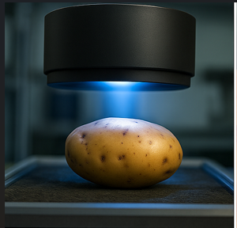
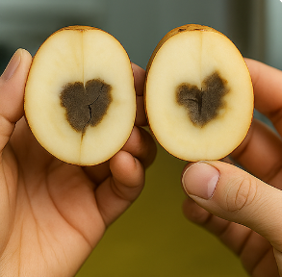
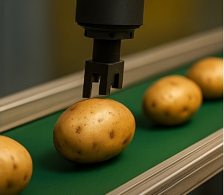
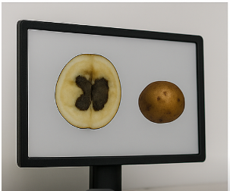
PROBLEM STATEMENT:- Build a non-invasive AI system that detects internal defects (hollow heart, black heart, Internal Heat Necrosis) in potatoes before they reach the buyer.

Slide 3
DESCRIPTION
The proposed system is a non-invasive AI-based quality detector for potatoes that identifies internal defects such as hollow heart, black heart, and internal heat necrosis before reaching consumers. Potatoes are scanned using near-infrared (NIR), shortwave infrared (SWIR), or low-dose X-ray imaging, which can penetrate the tuber without damage. The captured images are preprocessed and analyzed by a deep learning model trained on labeled samples to recognize defect patterns. Based on the model’s predictions, the system classifies each potato as healthy ,hollow heart, black heart or Internal Heat Necrosis in real time. This ensures fast, accurate, and non-destructive quality control, reducing waste and maintaining high standards for buyers.

Slide 4
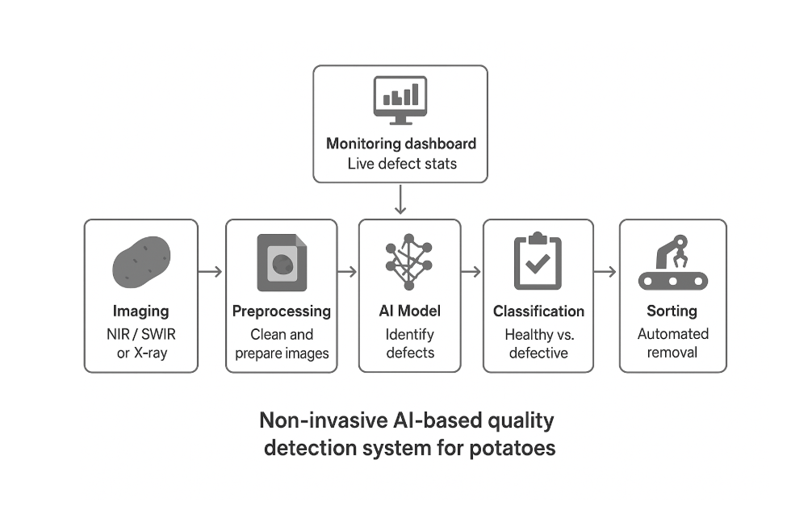
Manual

Slide 5
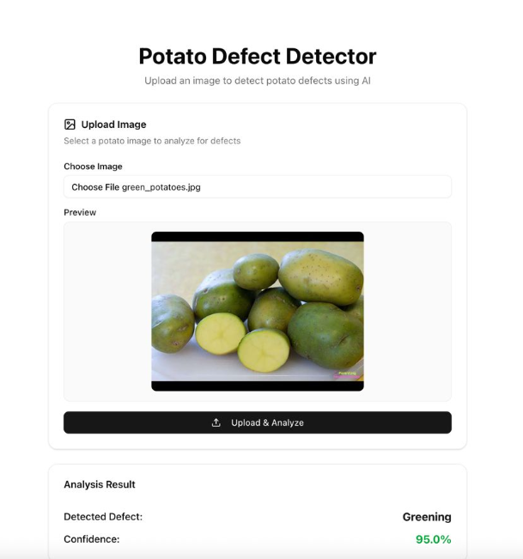
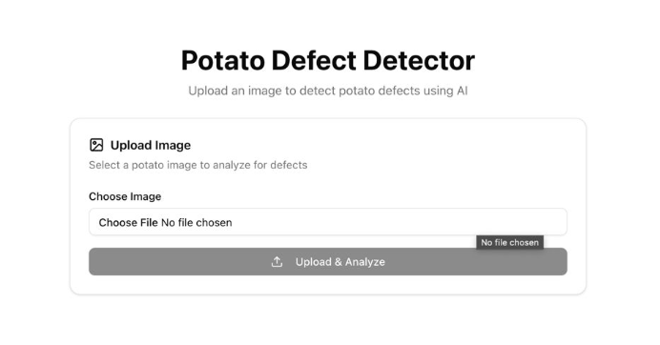
FRONTENED LAYOUT
Without Loading Image
After Loading Image

Slide 6
Choose File Button:-
Function: Lets the user browse and select an image (e.g., a potato photo) from their device.
Without selecting a file → It shows “No file chosen”.
After selecting a file → It displays the file name.
Upload & Analyze Button:-
Function: After choosing an image, clicking this sends it to the AI model for analysis.
Before choosing an image → Still clickable, but will not analyze until a file is selected.
After choosing an image → Becomes active to process the uploaded photo.
Analysis Result Section:-
Appears only after uploading and analyzing.
Purpose: Gives the final AI analysis output for the uploaded potato image.

Slide 7
CONCLUSION:-
The proposed AI-based potato quality detection system provides a fast, accurate, and non-destructive method to identify internal defects such as hollow heart, black heart, and internal heat necrosis. By using advanced imaging techniques and deep learning analysis, the system ensures high-quality control, reduces wastage, and guarantees that only healthy potatoes reach consumers. This innovative approach enhances efficiency in the agricultural supply chain and sets a new standard for quality inspection.

